Slide 1
Lecture 9
STAT 451 VISUALIZING DATA
Fall 2025
Many thanks to Prof. Abel Rodriguez, many slides from this course are adapted from his data visualization class.

Slide 2
What is spatial data?
In the past we classified data as:
Quantitative or qualitative.
Temporal, spatial or panel.
Spatial data involves data that refers to events occurring at specific geographic regions and that are naturally represented using thematic maps.
A thematic map is a type of map or chart especially designed to show a particular theme connected with a specific geographic area.

Slide 3
Different types of spatial data …
Point process data: exact location where events happen is important (e.g., location of robberies in Santa Cruz county)
Point referenced data: we can potentially have a measurement at each possible latitude/longitude (e.g., rainfall in Santa Cruz county).
areal (lattice) data: data is aggregated over geographical regions (zip codes, counties, states, countries) (e.g., number of cancer deaths in each U.S. state).

Slide 4
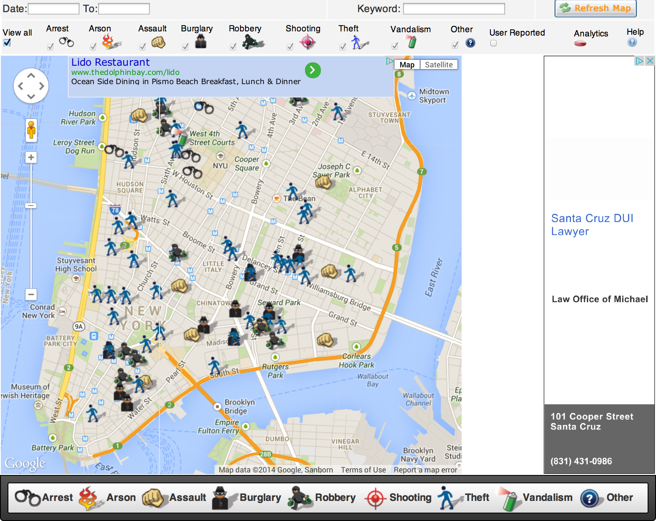
Point process data: Crime in Manhattan
http://spotcrime.com/ny/new+york

Slide 5
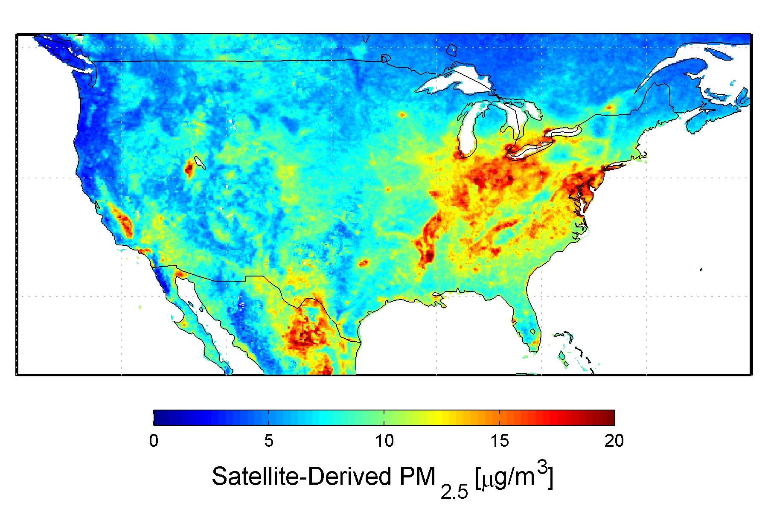
Point-referenced data: concentration of particulate matter 2.5mm

Slide 6
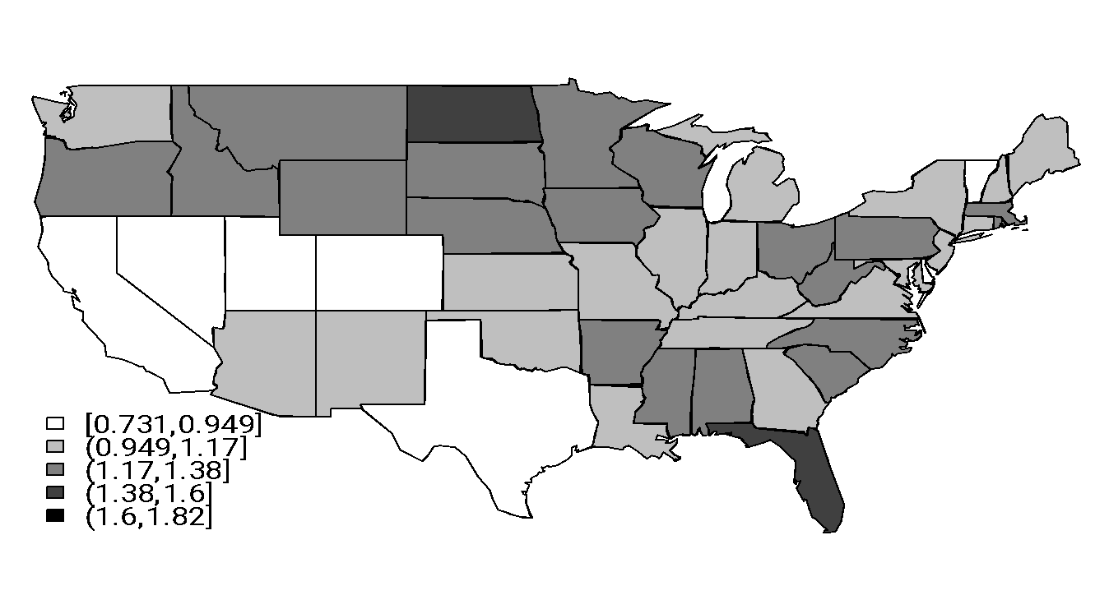
areal data: Prostate cancer death rates in the US
Exact residence of the subject is not important
We plot the rate (number of cases divided by population) rather than just the number of cases.

Slide 7
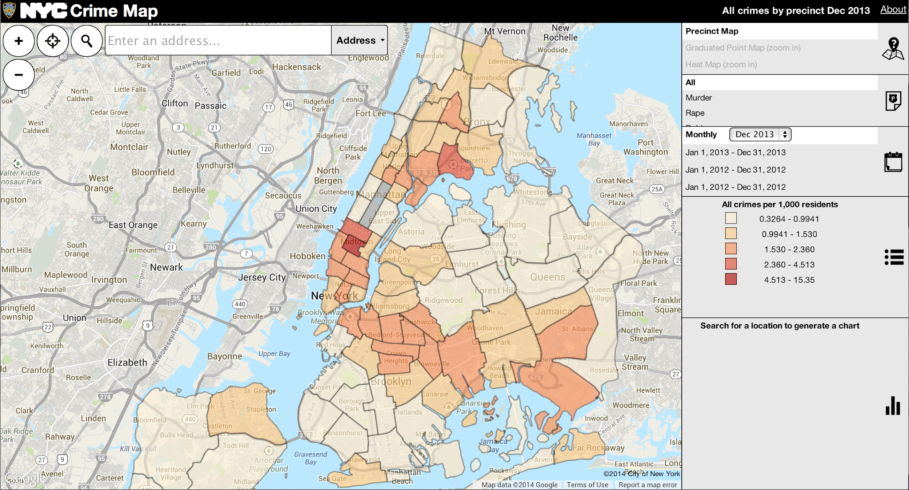
Sometimes point process data is aggregated to create areal data …
Provides less detail, but it is more useful for large geographic regions.
http://maps.nyc.gov/crime/

Slide 8
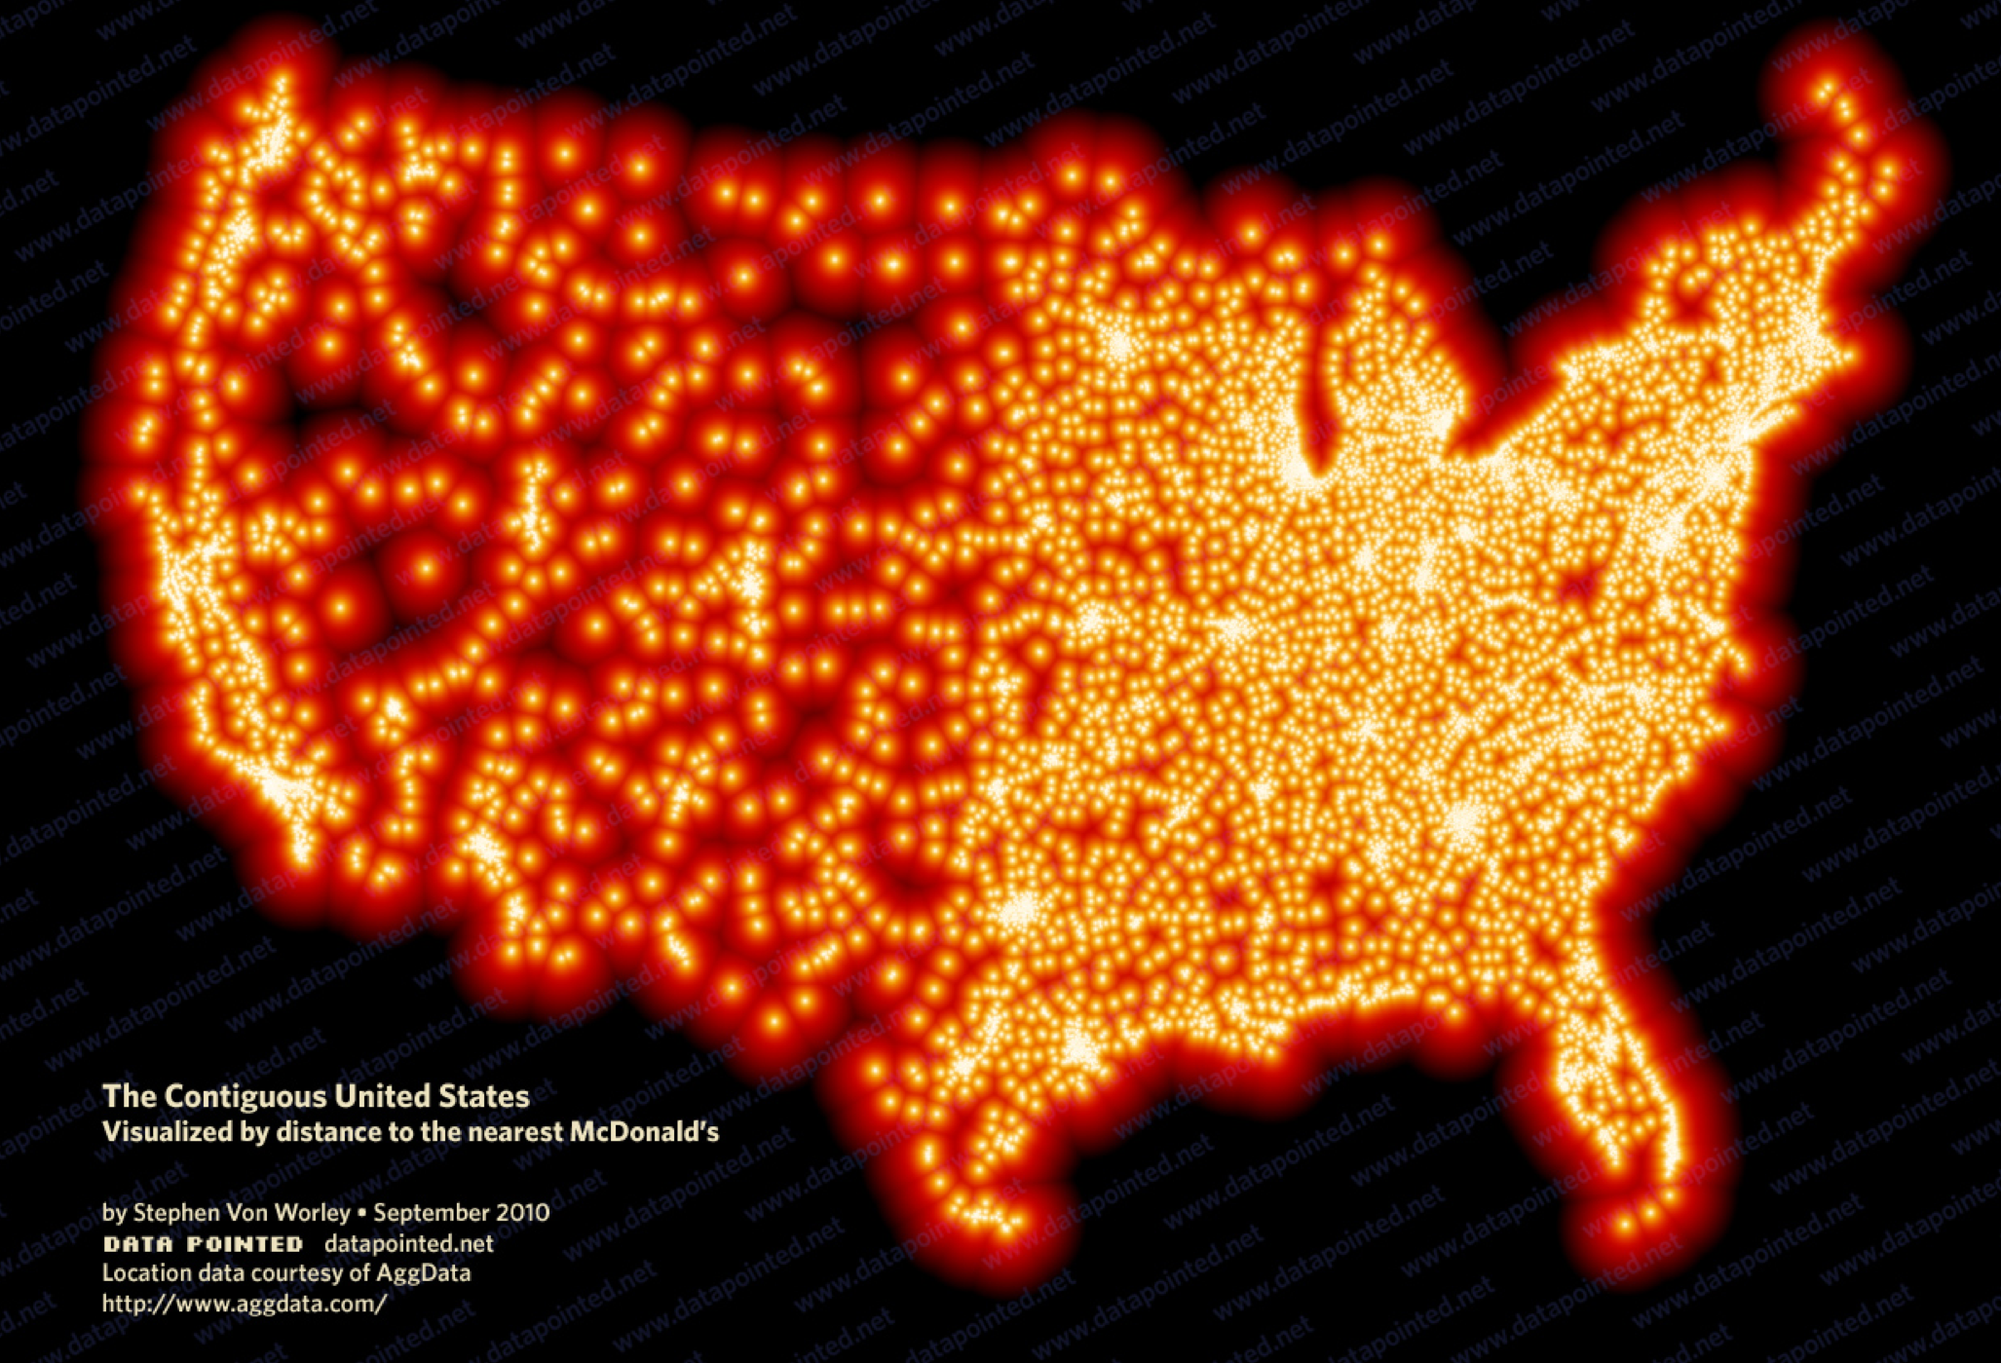
Mixing point referenced and point process data …

Slide 9
Marked point process
In marked point processes we are interested in where the event occurs, but also on the value of some other variable associated with each occurrence:
The location of the McDonalds is a point process.
The distance of a location to the closest McDonalds corresponds to point-referenced data.
The data on crime is actually a marked point-process (because we also care about the type of crime).

Slide 10
Representing point processes
To represent a point process you only need to add points to a map, which can be easily done using the function points we had introduced before.
The location of the points needs to be defined using longitude/latitude.
If you have a marked point process, additional variables can be represented using bubbles centered around the events.

Slide 11
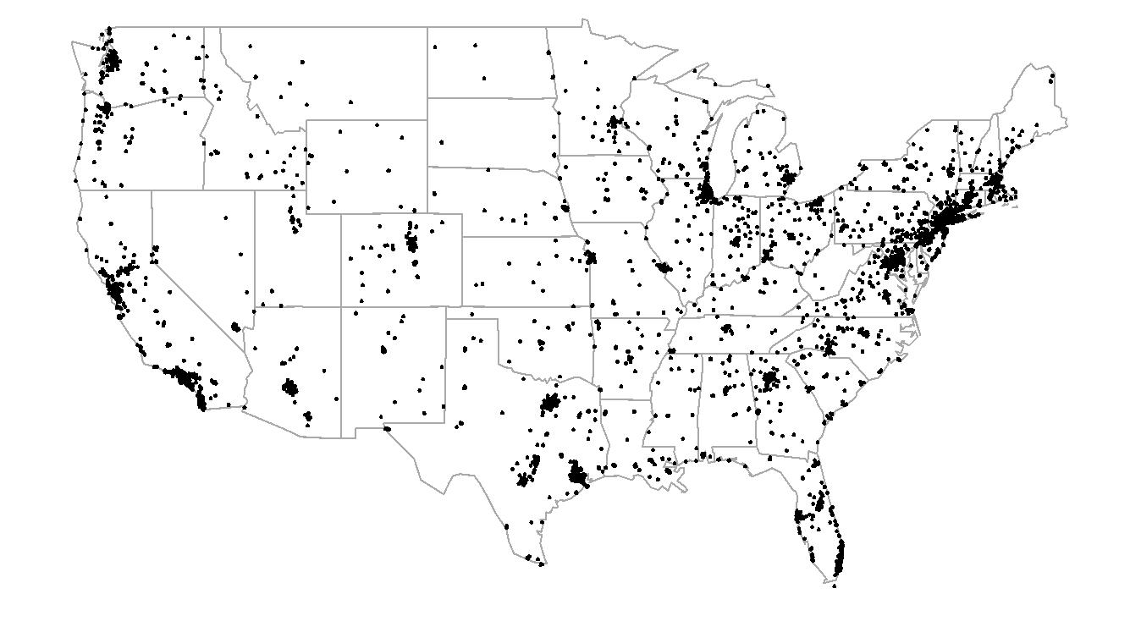
Yellow fever vaccination centers

Slide 12
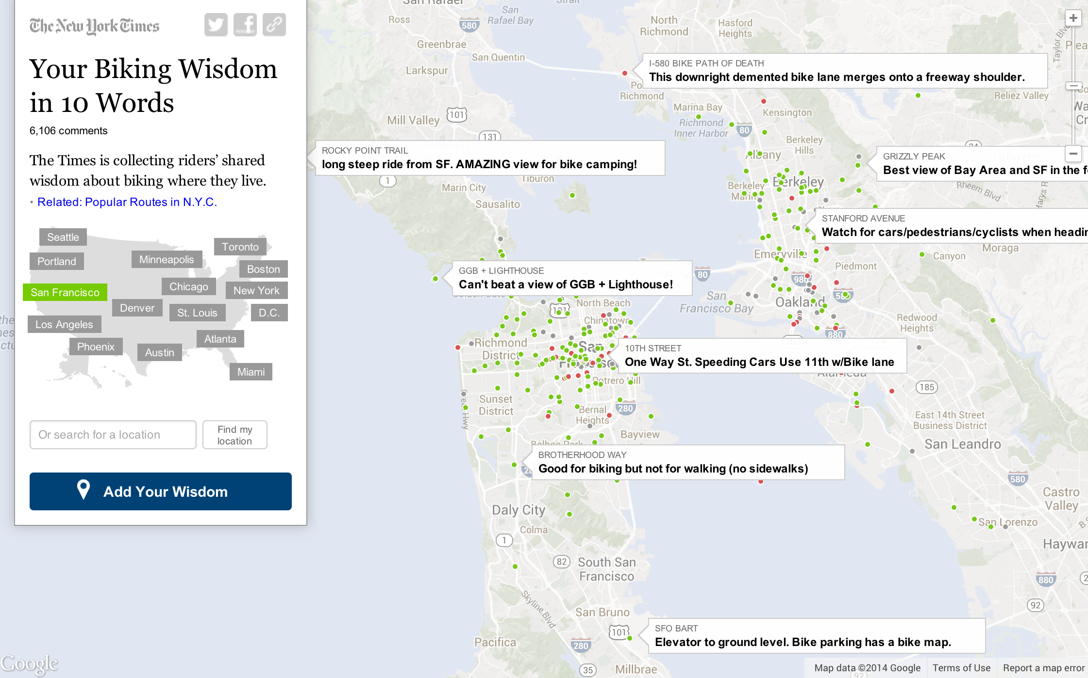
An interactive map of a marked point process with text marks

Slide 13
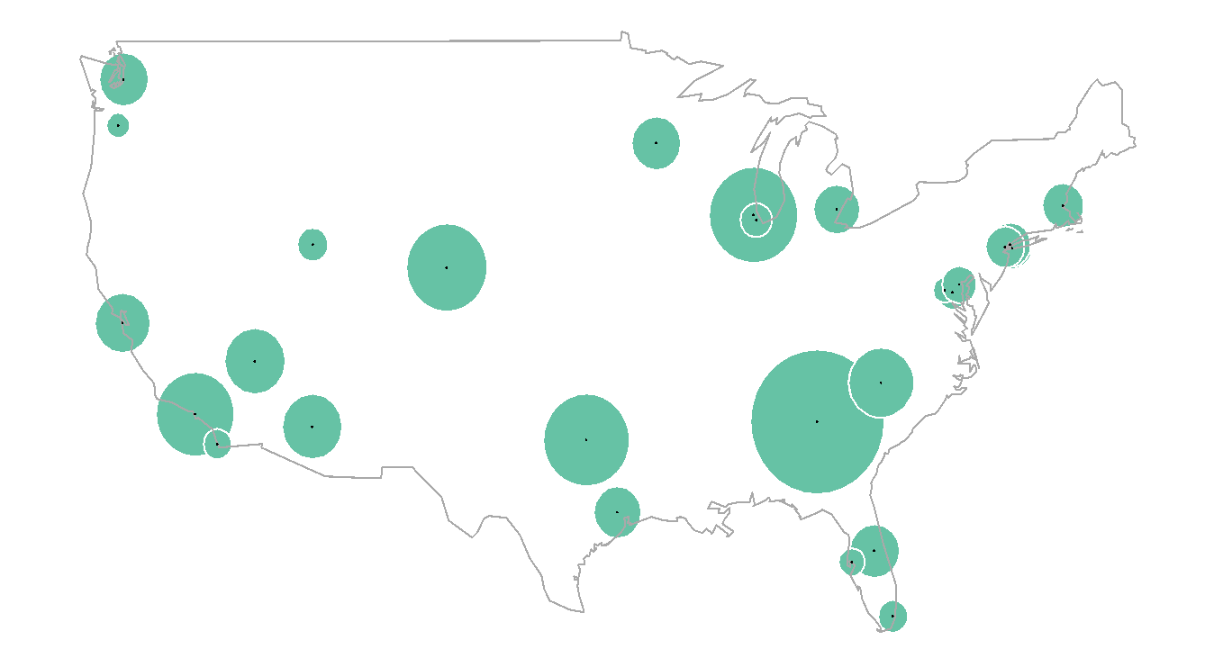
Location of major US airports and number of arriving passengers in 2013
Note that a white boundary helps separate the bubbles of nearby airports!!

Slide 14
Location of major US airports and number of arriving passengers in 2013
Additional information can be encoded:
Part to whole relationships (e.g., how many passengers are from each airline) could be depicted by converting the bubbles into pie charts.
Other quantitative or qualitative variables could be encoded using the color of the bubble.
Note that this graph is good at showing you the big picture (in particular, how geography seems to affect passenger volumes), but does not allow for accurate comparisons.
It would be useful to complement this map with a bar plot!

Slide 15

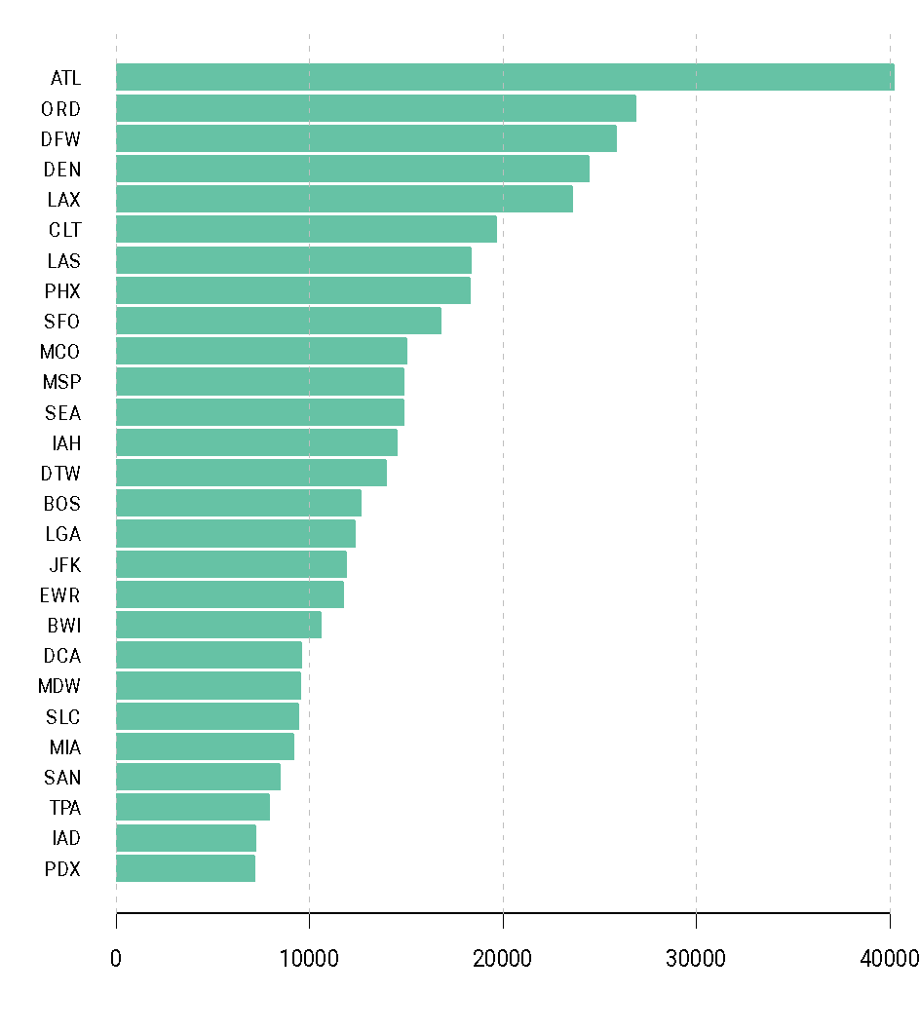
Location of major US airports and number of arriving passengers in 2013

Slide 16
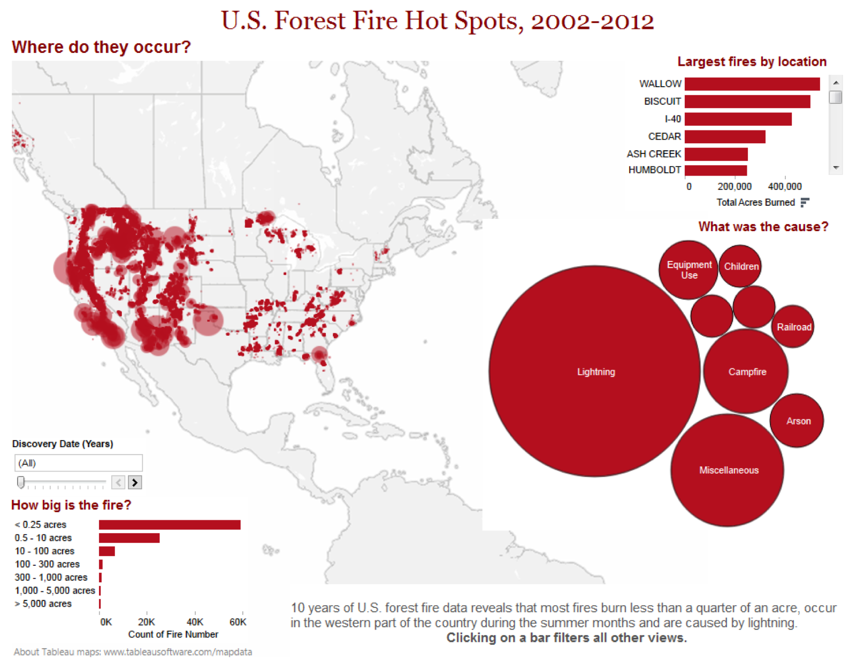
Forest fires in the U.S.

Slide 17
Representing areal data
Data aggregated over geographical regions is prevalent in social sciences.
Hence, areal data is the most common type of data that you will use in your projects.
Main types of visualizations for areal data are
Choropleth maps.
Bubble charts.
Cartograms.

Slide 18
Choropleth maps
A choropleth map is a thematic map in which areas are shaded or patterned in proportion to the measurement of the statistical variable being displayed on the map (e.g., population density or per-capita income).
It is important to represent normalized values(rates, densities) in choropleth maps.
The eye naturally integrates over areas of the same color, giving undue prominence to larger polygons of moderate magnitude and minimizing the significance of smaller polygons with high magnitudes

Slide 19
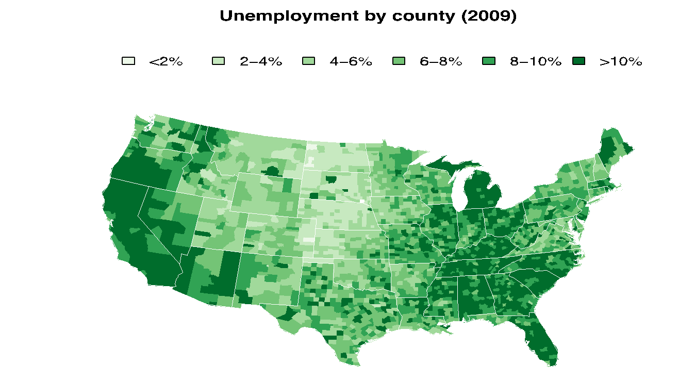
Example: Unemployment rates

Slide 20
Choropleth maps
An interesting example involving baby names:
http://flowingdata.com/2013/11/18/regional-names/
Drought in the US.
http://www.nytimes.com/interactive/2012/07/20/us/drought-footprint.html
Map of the 2008 US presidential election:
http://elections.nytimes.com/2008/results/president/map.html

Slide 21
Proportional symbol maps
In some cases, proportional maps (which typically use bubbles and are similar to the ones we created for representing marked point processes) are used to represent areal data.
In this case the bubbles are usually centered at the geographical center of the region (state/county).

Slide 22
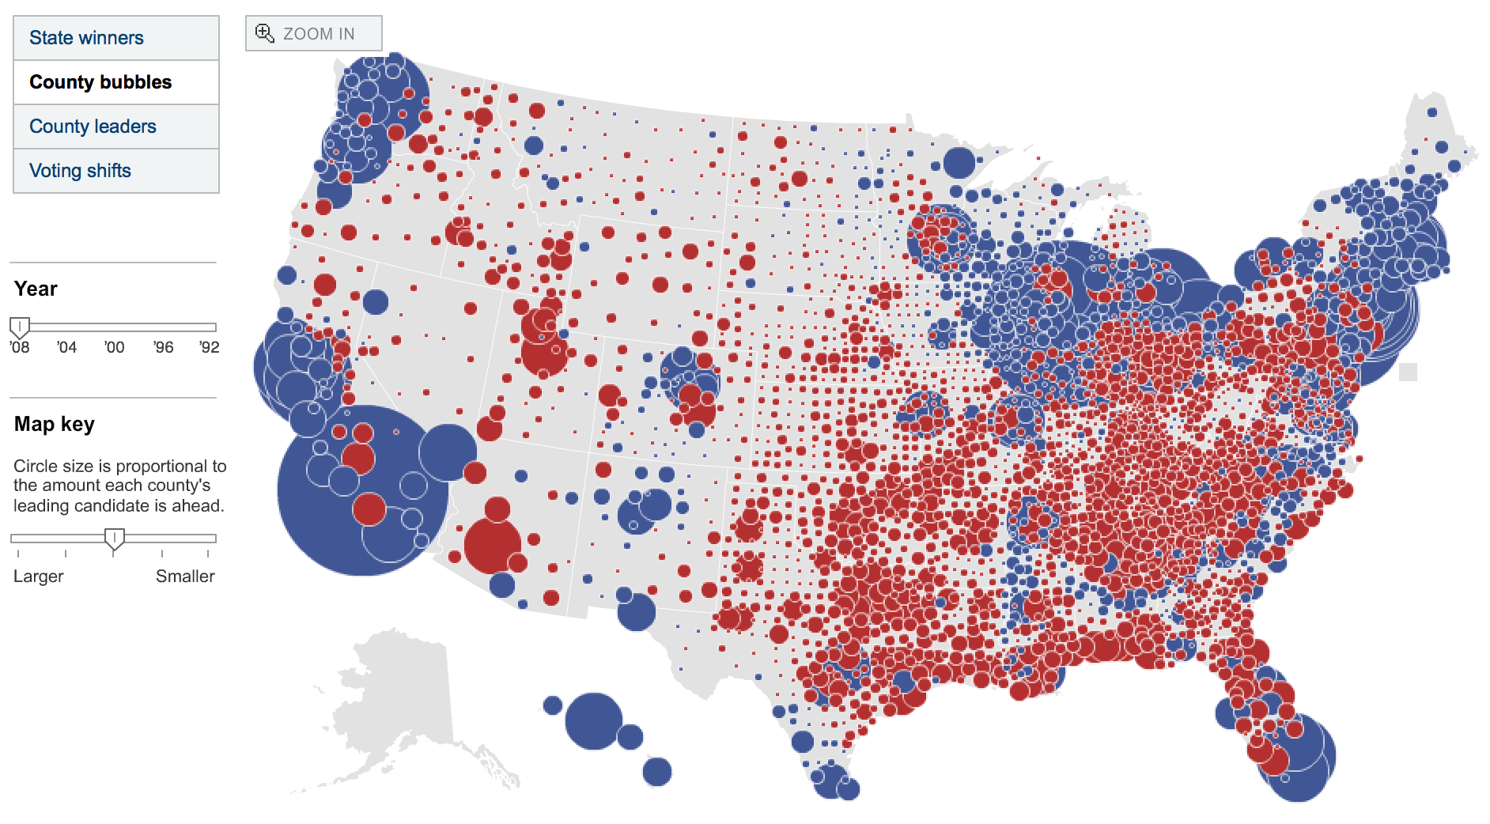
Proportional symbol maps
http://elections.nytimes.com/2008/results/president/map.html

Slide 23
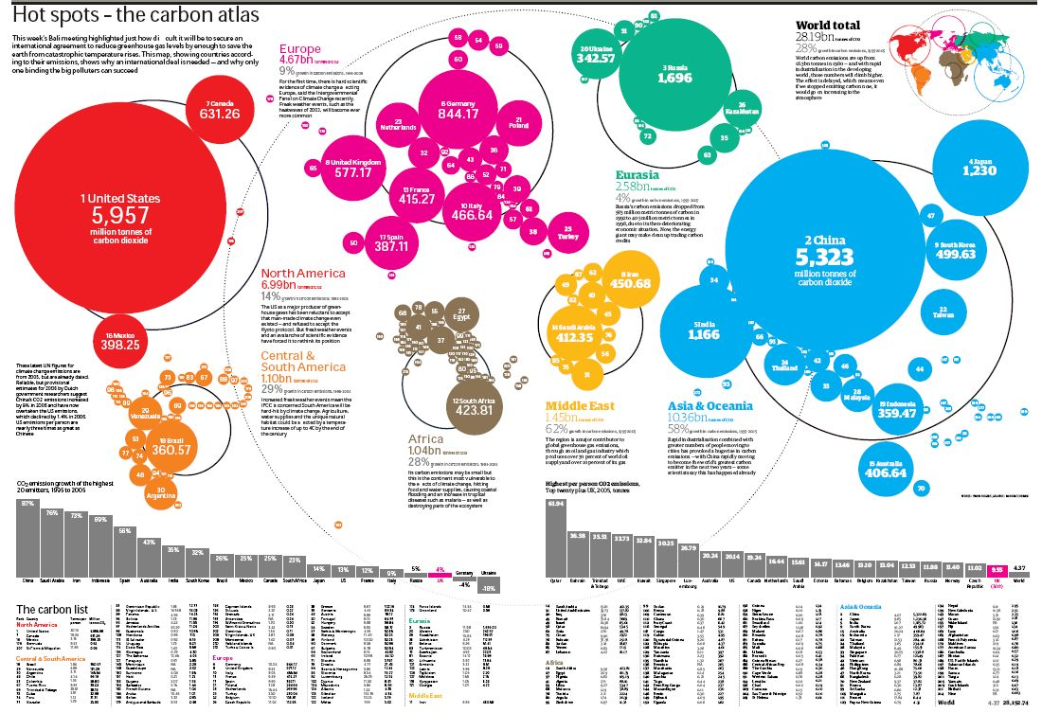
Proportional symbol maps (Abstract)

Slide 24
Bricks vs. bubbles
Stephen few suggests using stacked bricks (essentially, unit charts like the ones we discussed at the very beginning of the course) as an alternative to proportional symbols.
He argues that they allow for more accurate comparisons (which tangentially implies that they better show variability).
http://www.perceptualedge.com/articles/visual_business_intelligence/building_insight_with_bricks.pdf

Slide 25
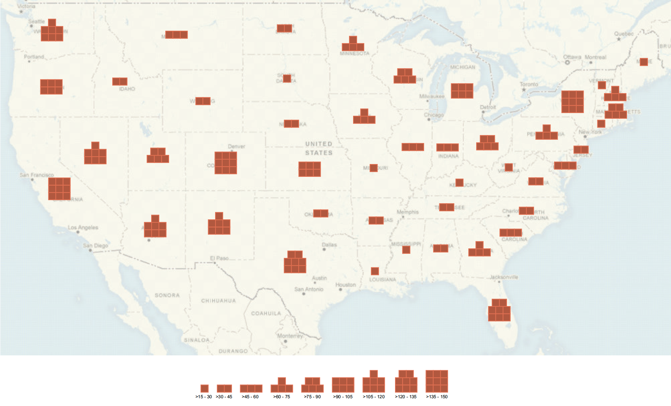
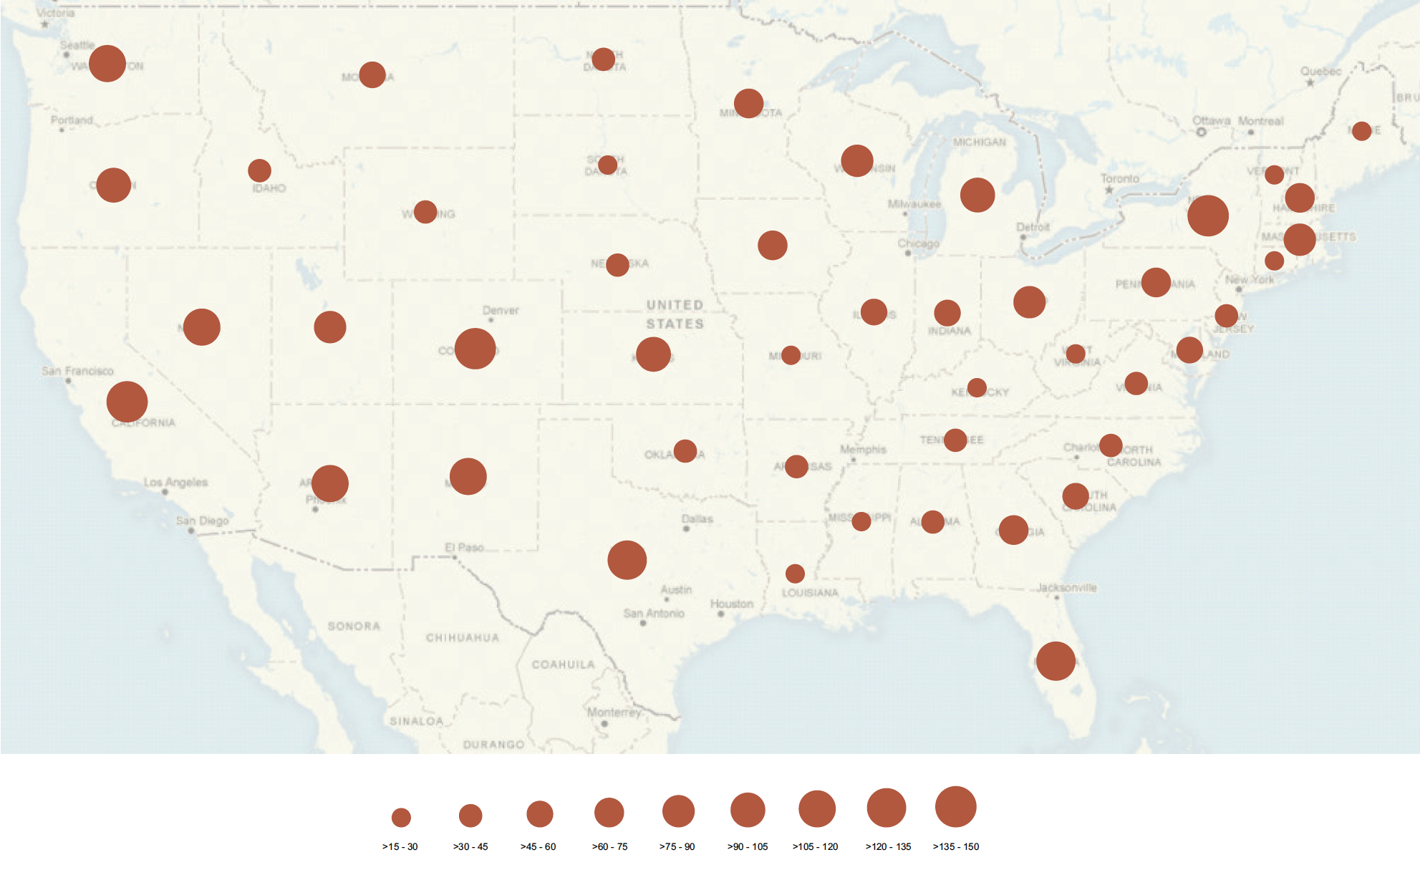
Bricks vs. bubbles
http://www.perceptualedge.com/articles/visual_business_intelligence/building_insight_with_bricks.pdf

Slide 26
Proportional symbol maps
Bubble maps have two potential advantages over choropleth maps:
It allows us to represent more than one variable at a time (you can use area and color scheme).
Because areas are higher in the cognitive hierarchy than color, they allow for slightly more accurate comparisons.
In spite of this, I still tend to prefer choropleth maps:
Areas do not allow for very accurate comparisons (you will need to supplement the map anyway).
Packing too much information in a single graph can be counterproductive …
Bubbles on nearby regions that overlap are hard to see and understand.

Slide 27
Cartograms
Cartograms modify the size of different geographical regions so that they represent a variable other than area.
A subclass of cartograms that I will call varying-size cartograms keep the general shape of the regions, and just alters its size.
A subclass of cartograms is called diffusion maps and completely alters the geography of the regions.
Cartograms are highly decorative and amusing and can help emphasize specific arguments!

Slide 28
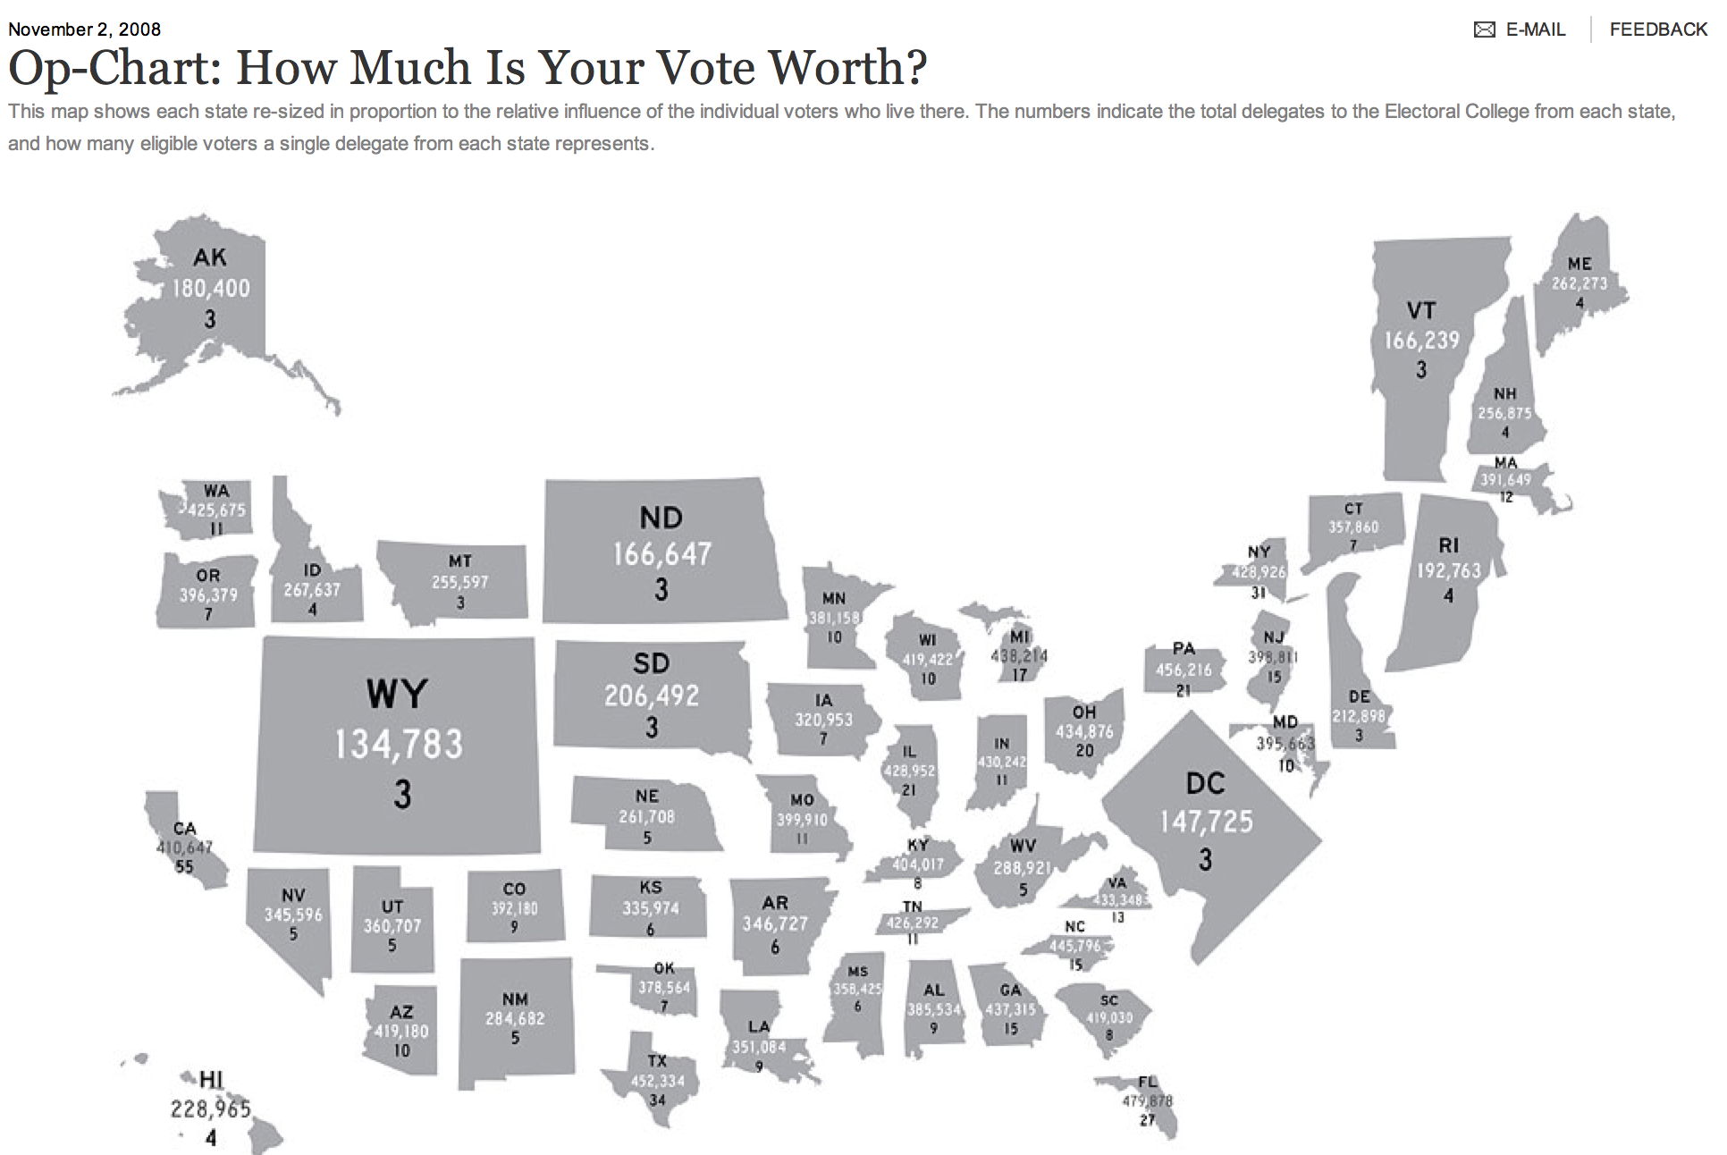
Cartograms – Varying-size
http://www.nytimes.com/interactive/2008/11/02/opinion/20081102_OPCHART.html

Slide 29
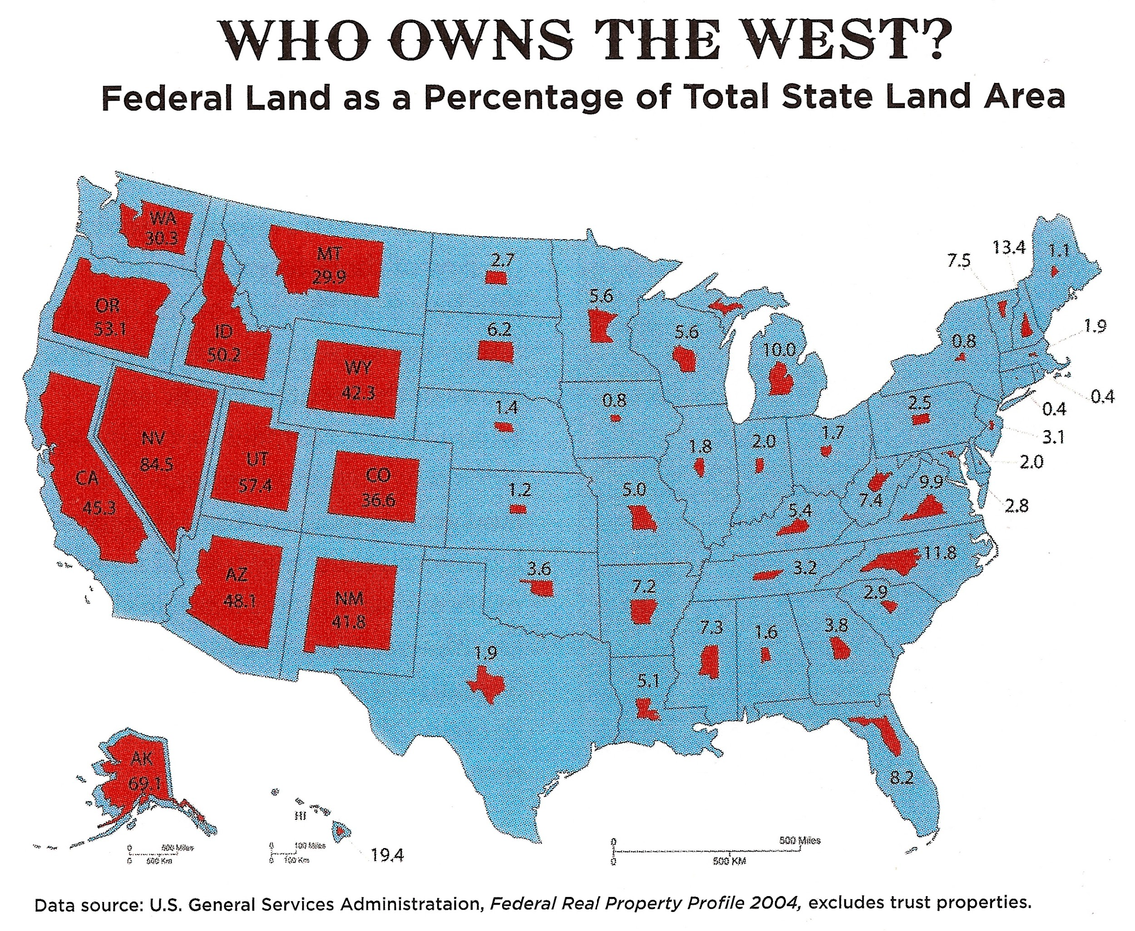
Cartograms – Varying-size

Slide 30
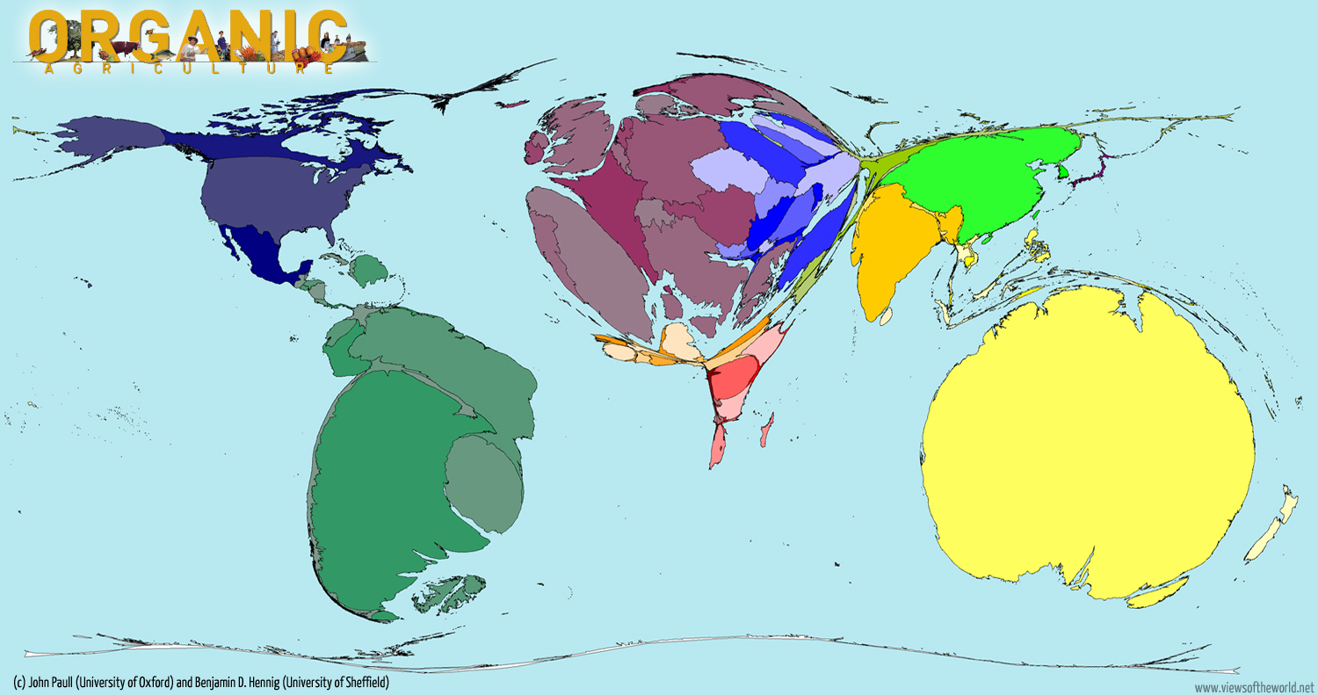
Cartogram – Diffusion maps
http://www.viewsoftheworld.net/?p=2208

Slide 31
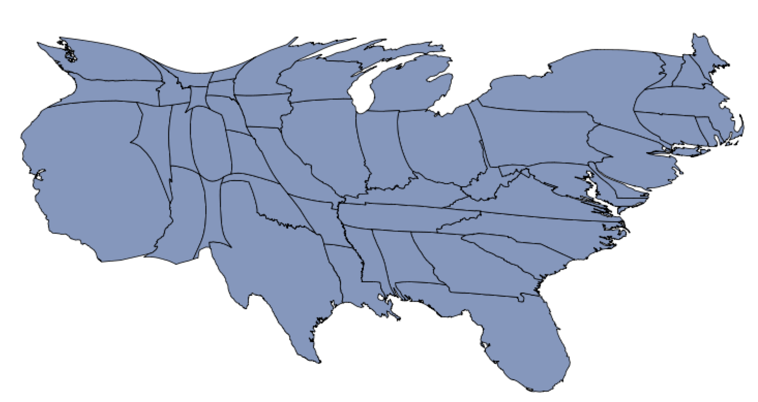
Cartograms – Diffusion maps
US population, 2009
http://cart.r-forge.r-project.org

Slide 32
Diffusion maps
Opinions are split about the utility of diffusion maps (and cartograms) for facilitating comparisons.
Supporters argue that, in many social phenomena, values associated with areas with very different population are distorted by the fact that they densities can be very different (that is why we always want to represent normalized values in chloropeth maps). Cartograms attempt to solve this issue.
However, comparing areas is hard, particularly when regions are so irregular and different. The main use of maps is not to allow for accurate comparisons, but to allow for exploration of spatial patterns! Other types of visualizations are more helpful for comparisons.

Slide 33
Representing point referenced data
The main tool for representing point referenced data is isopleth maps.
Isopleth maps, also known as contour maps, smooth continuous phenomena such as precipitation or elevation. Each line-bounded area on this type of map represents a region with the same value.

Slide 34
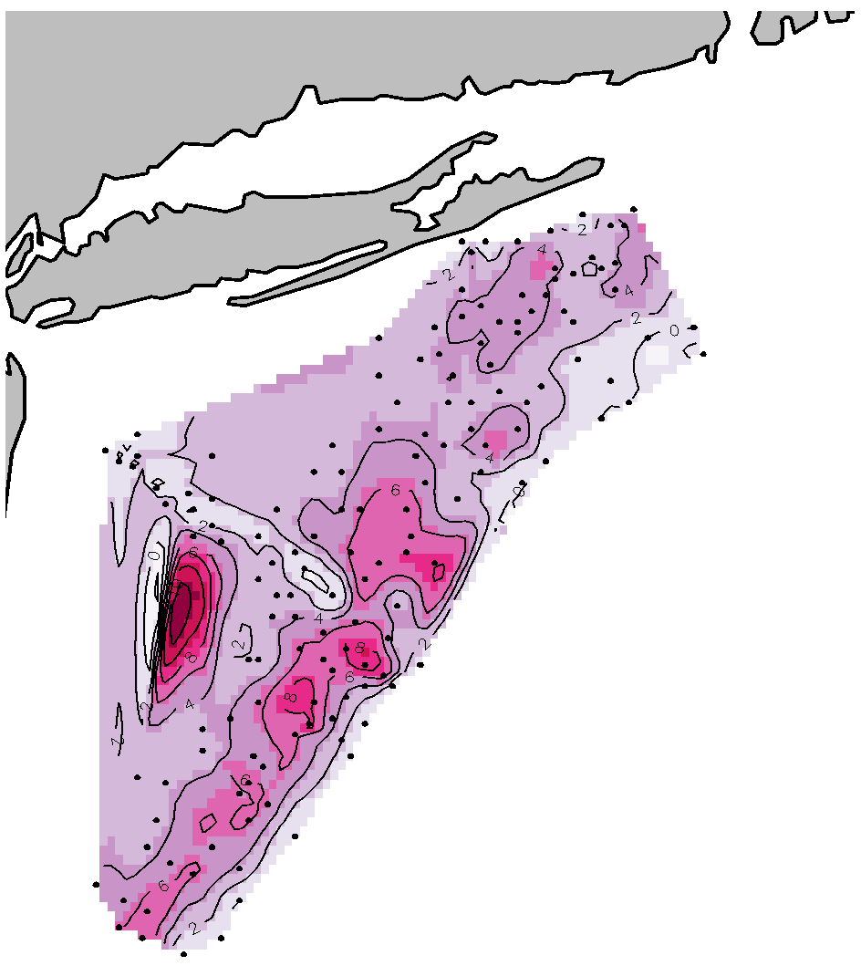
Isopleth maps
Logarithm of the size of the scallop catch outside Long Island/New Jersey
Points show locations where fishermen attempted to catch scallops.
Very low level!
Pollution from the Hudson River?
Scale is missing!

